Slide 1

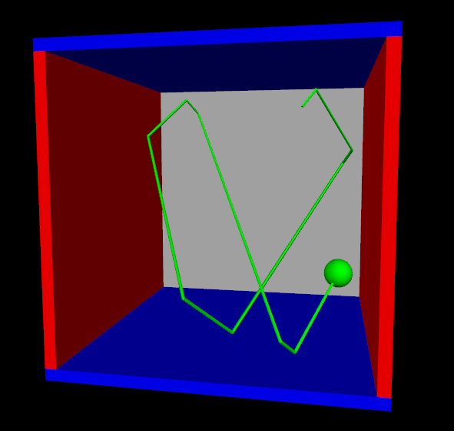
Simulating Planetary Orbits in VPython
By Janel Williams

Slide 2
What is Python/VPython?
Python is a programming language
Vpython was originally called “visual python”before updates
A programming language that allows both novice and experienced programmers/researchers to create 3D displays and animations
Site subtitle: “3D Programming for Ordinary Mortals”
My goal in using it
I used Vpython to create two different, but linked visual representations of planetary orbits in the system K2 - 266
3D animated orbits
Graphs that track changes in velocity vectors of each orbit

Slide 3
What I needed and where I got it
Constants
Planet/star mass
Planet/Star Radii
Gravitational Constant
Semi - major Axis
etc...
Conversion Factors
Jupiter mass → Kilograms
Jupiter Radii → km
au → km
etc..

Slide 4
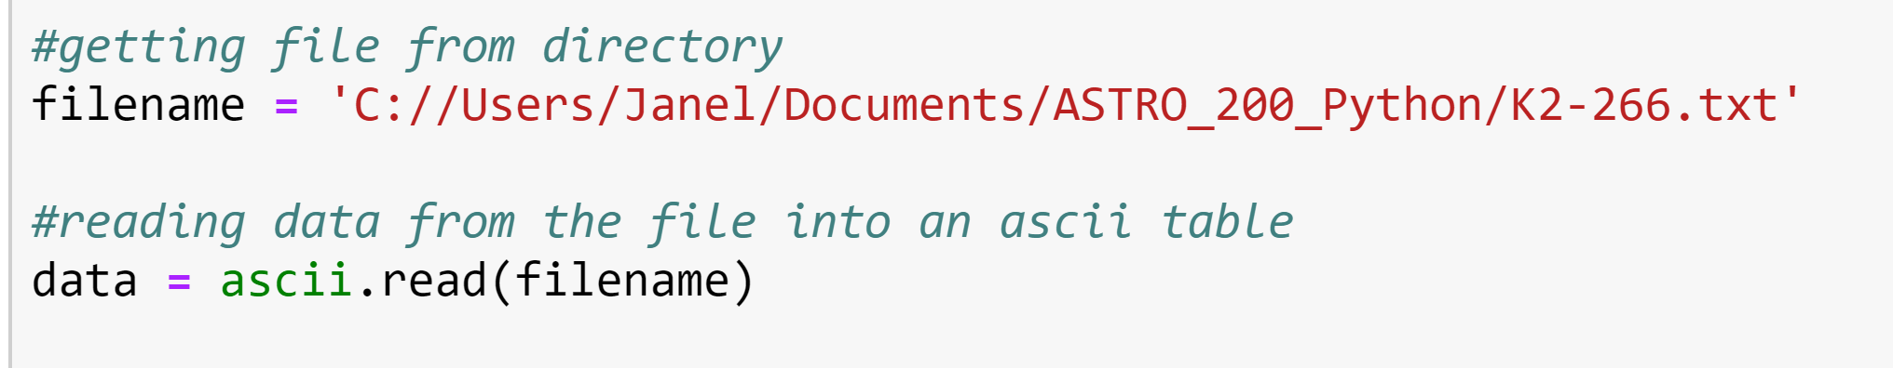


What I needed and where I got it
Constants
Planet/star mass
Planet/Star Radii
Gravitational Constant
Semi - major Axis
etc...
Conversion Factors
Jupiter mass → Kilograms
Jupiter Radii → km
au → km
etc...
From NASA Exoplanet Archive

Slide 5
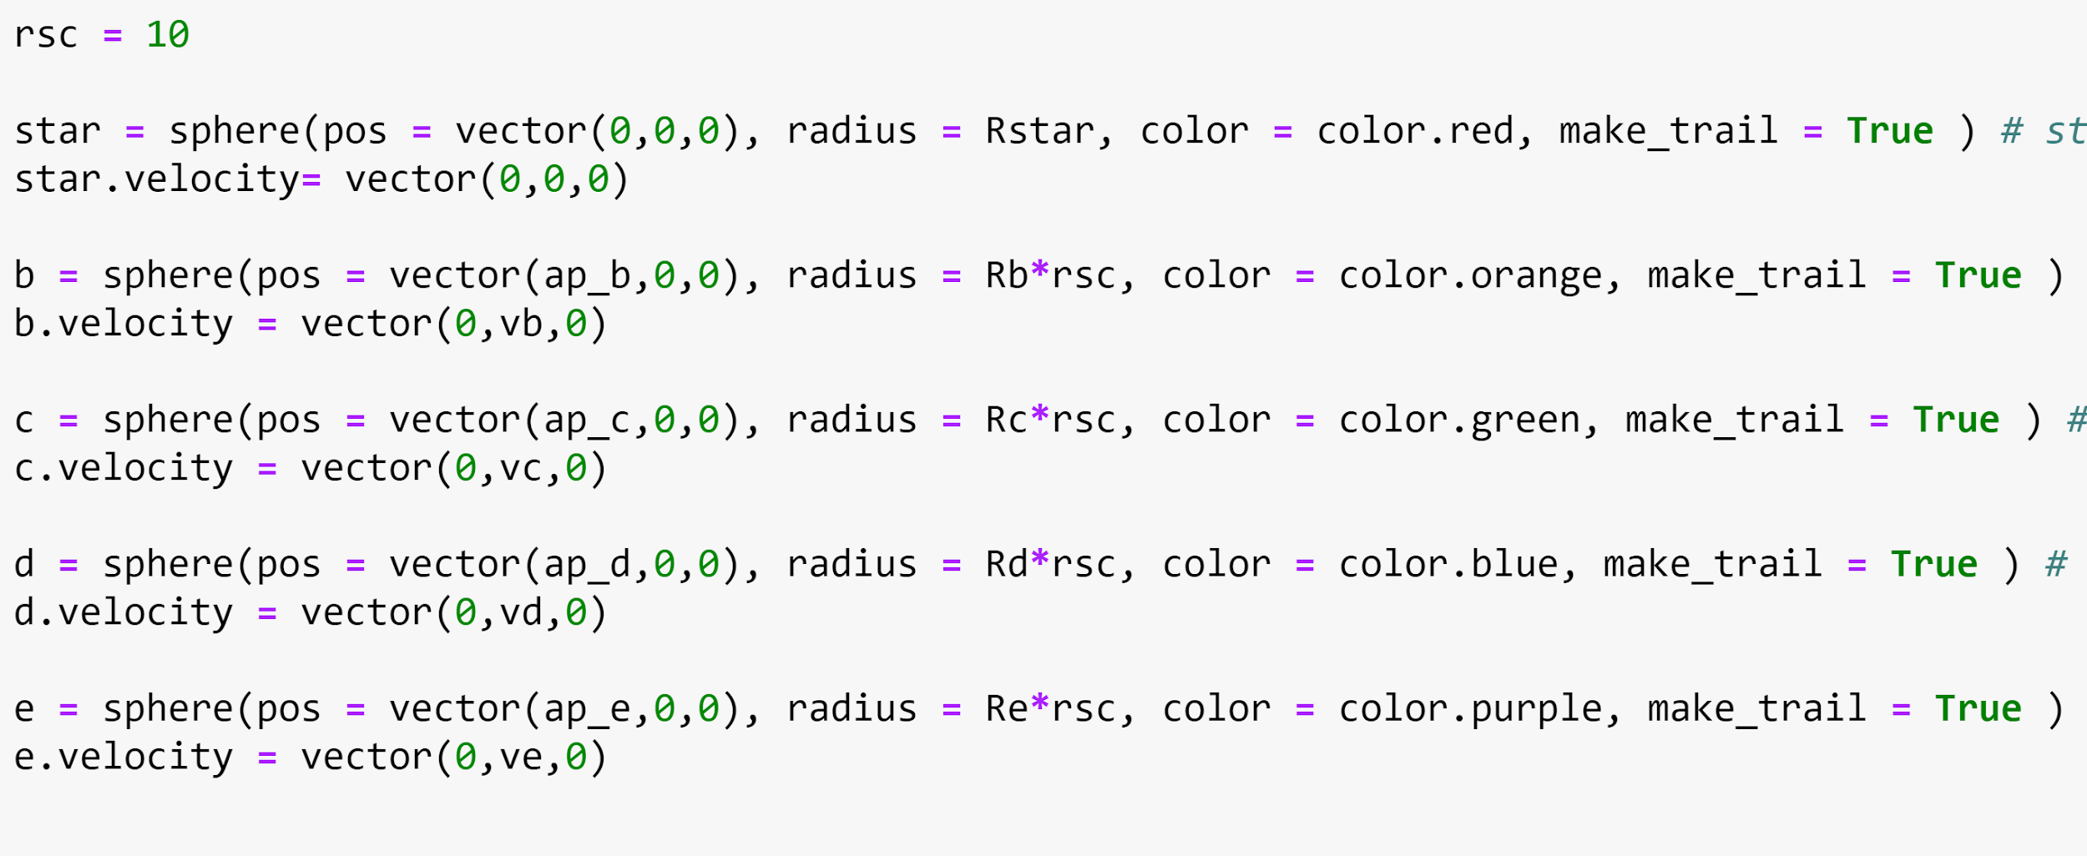
Defining shapes and vectors

Slide 6
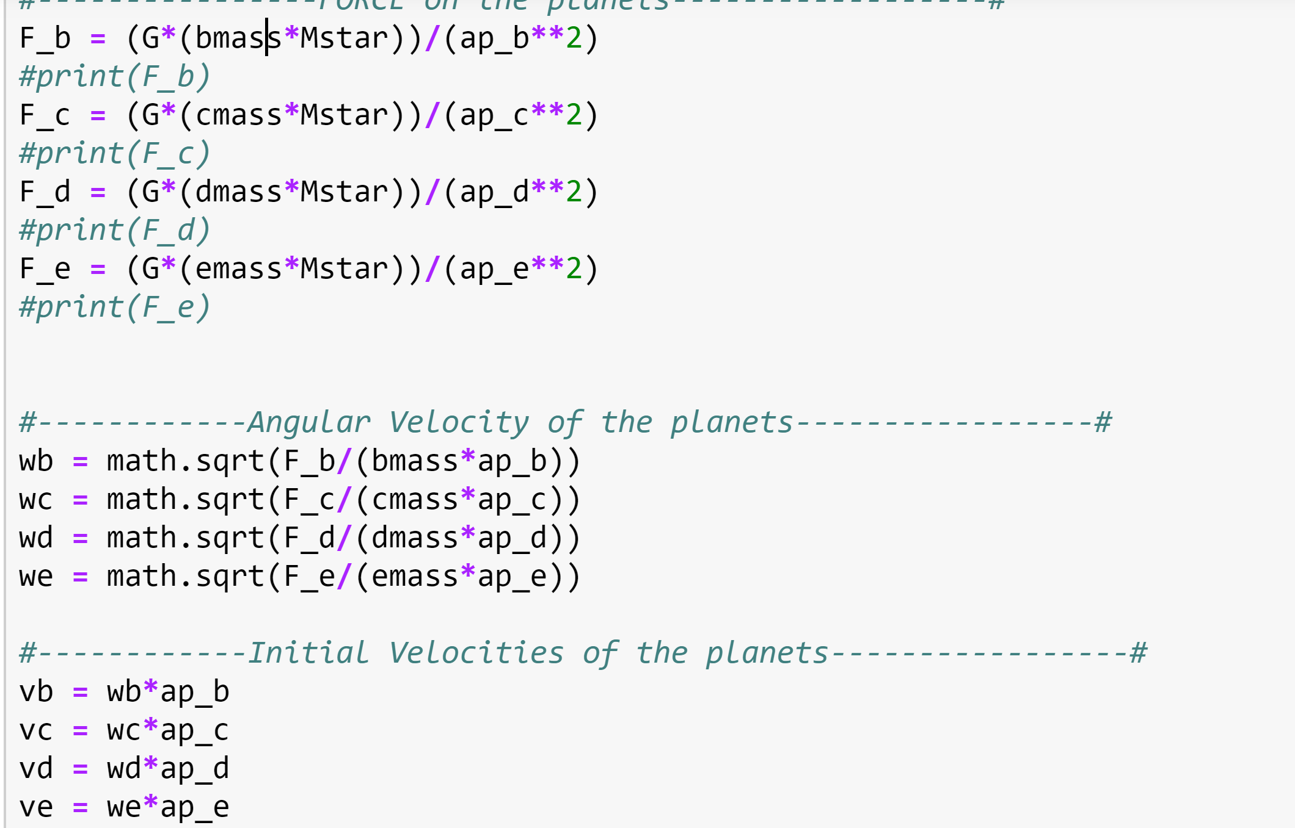
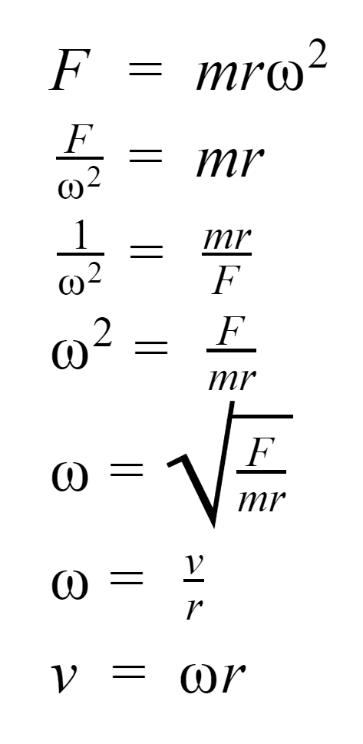
Gravitational force, Initial Value
F_B = force on planet b
bmass = mass of planet Mstar = mass of the star
ap_b = semi major axis
wb = angular velocity

Slide 7
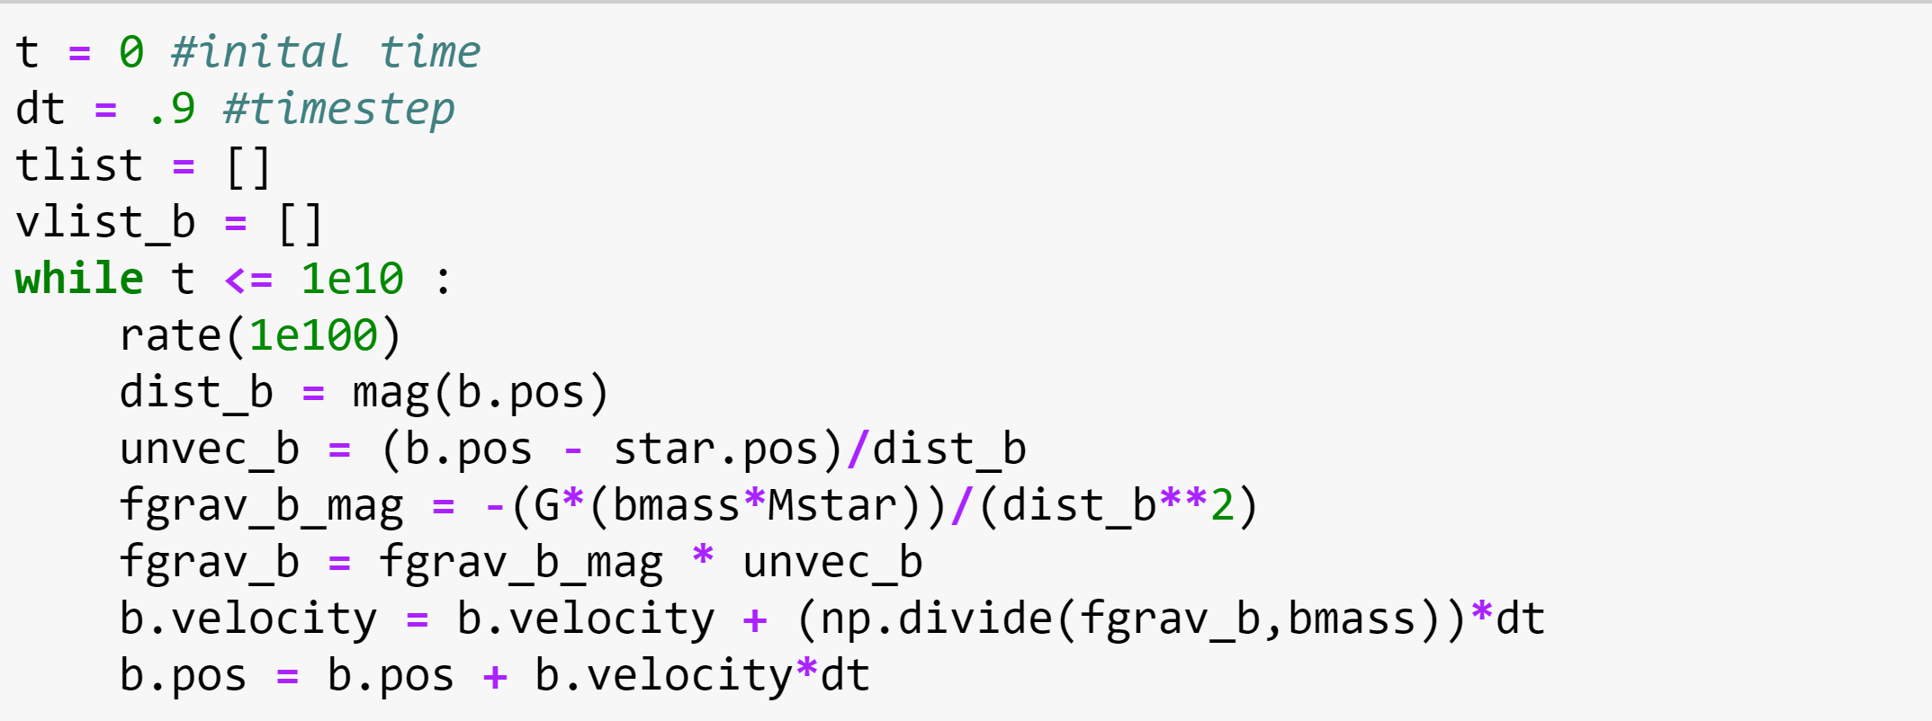
Making it move!
Updating velocities based on the force of gravity, then updating the positions based on the velocity
All functions dictated by time (t), time step (dt), rate rate()
Multiplying by Mp/Mstar to get total of x, y, and z components to capture the reflex motion of the star

Slide 8
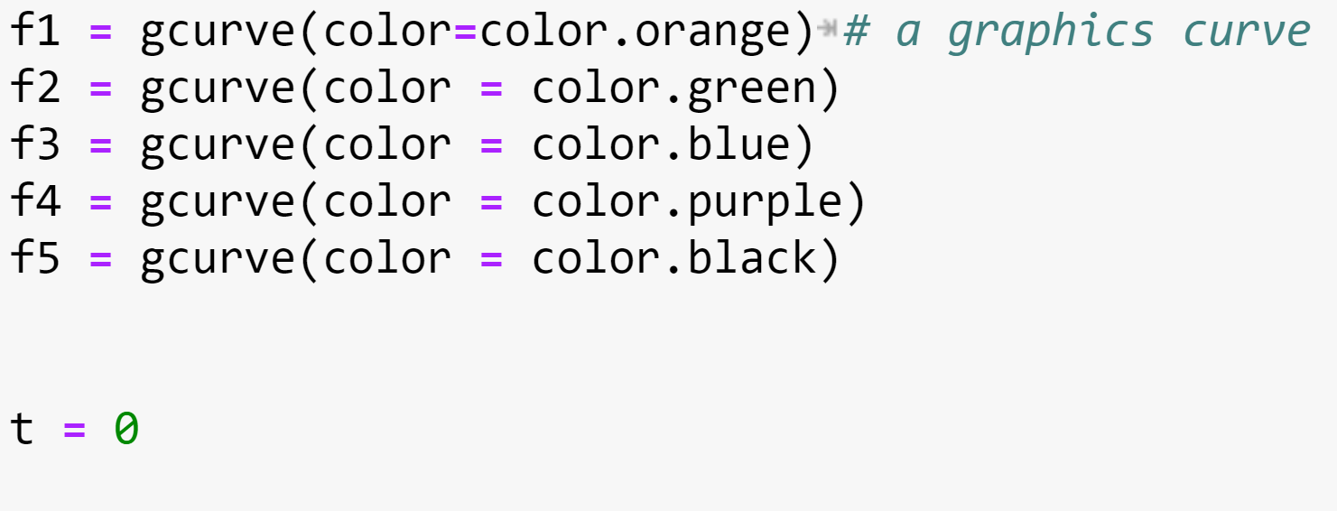
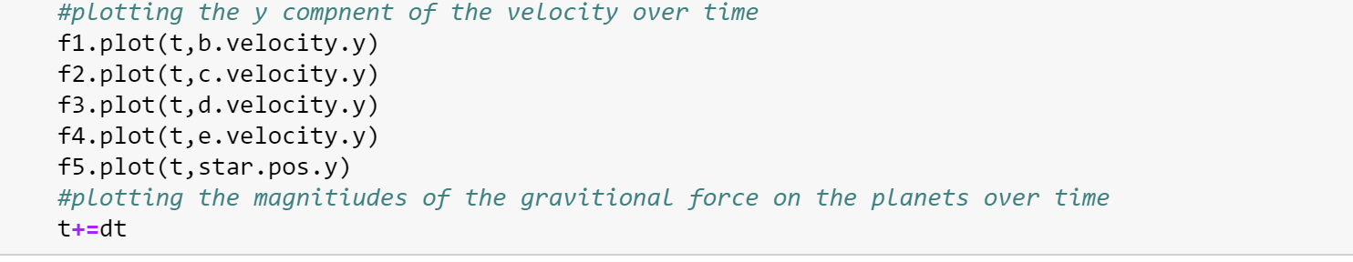
Graphing and Making it move!
→ Initializing Step (outside of loop)
→ Tracking step (in loop, only y component)

Slide 9
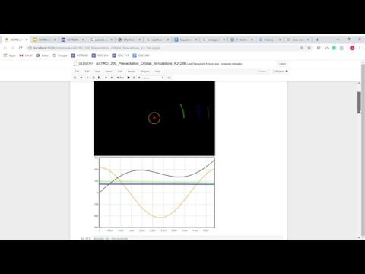
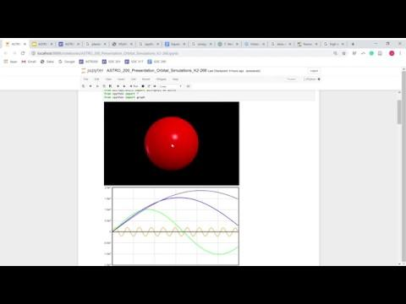
Final Result!
Simulation and t vs velocity in the y direction graphic
Star’s motion with the influence of all four planets

Slide 10
Final things…
Trying to find a way to incorporate eccentricity
Sources:
https://vpython.org/
https://www.wired.com/2015/03/glowscript-tutorial-8-gravity-orbits/
https://exoplanetarchive.ipac.caltech.edu/
http://www.softschools.com/formulas/physics/unit_vector_formula/83/

